Slide 1
Data Science Tolls -II

Slide 2
Introduction to Data Visualization
Data visualization is a process used to represent the data in the graphical format.
It is because of data visualization that various decision makers can gain insights as well as patterns and analyze it from the data represented visually.
Three major factors for data visualization
Clarity
Accuracy
Efficiency

Slide 3
Advantages of Data Visualization
It helps to recognize relationships among various variables in the data.
It makes it easier to perform mathematical calculations.
It is beneficial to analyze and explore the existing patterns, thus giving out the invisible patterns.
It helps to recognize the areas that need to be improved.

Slide 4
Introduction to Tableau
Tableau is a strong and rapidly expanding data visualization tool.
It is highly used in the business intelligence domain.
Tableau simplifies raw data into a format that is simple and easily intelligible.
Tableau makes data analysis easy and rapid.
Data visualizations created in the Tableau are along the lines of worksheets and dashboards.
The user does not need to be familiar with any technical knowledge or programming skills to use the Tableau software; thus, this data visualization tool has attracted many people from various domains.

Slide 5
Important features in Tableau
Data Blending
Real-Time Analysis
A Collaboration of Data

Slide 6
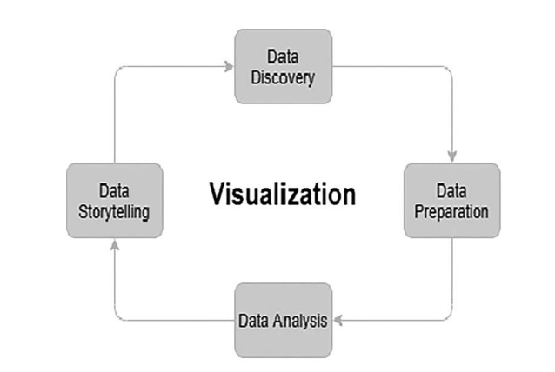
Analytics Cycle

Slide 7
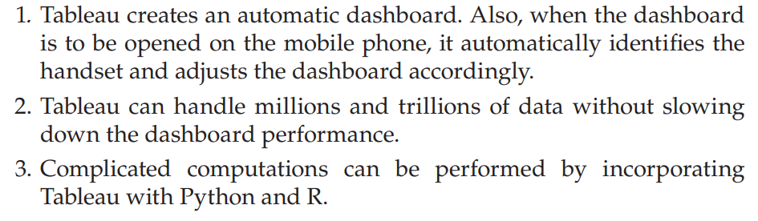
Advantages of Tableau

Slide 8
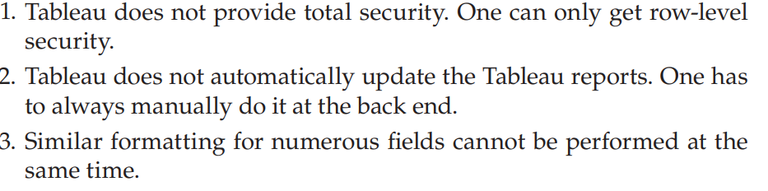
Disadvantages of Tableau

Slide 9
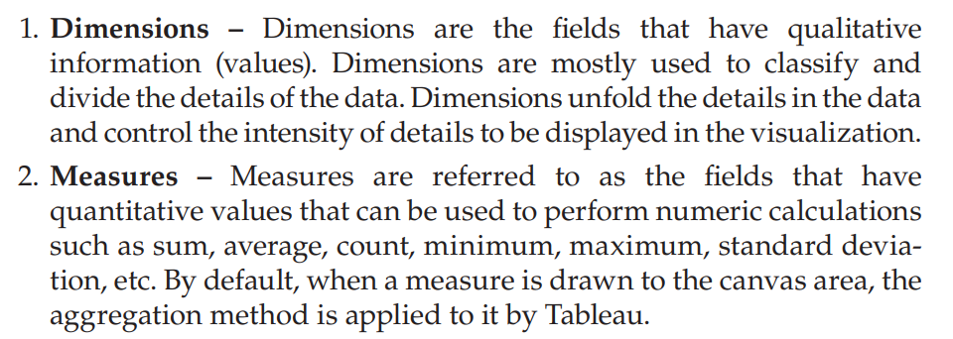
Dimensions and Measures

Slide 10
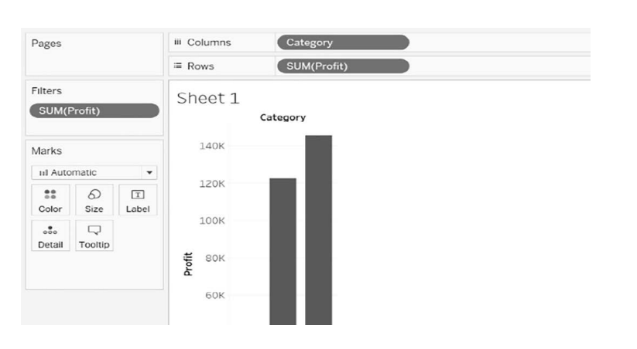

Slide 11
Cleaning and Structuring Messy Data
Cleaning and structuring messy data in Tableau can involve leveraging built-in Tableau features for data preparation, as well as Tableau Prep Builder for more complex task.
1. Import and Analyze the Data
Connect to your data source: Import the messy dataset into Tableau Desktop.
Preview the data: Use the Data Source tab to inspect data for inconsistencies, missing values, or irregularities.

Slide 12
2. Clean Data Using Built-in Features
In Tableau Desktop:
Rename Columns: Rename columns for clarity by double-clicking on the column headers in the Data Source view.
Change Data Types: Ensure each column has the correct data type (e.g., Date, String, Number). Click on the data type icon in the column header to change it.
Split Columns: Use the Split or Custom Split option to divide a column into multiple parts (e.g., splitting "FirstName LastName" into two fields).
Right-click on the column > Transform > Split.
Remove Duplicates: While Tableau doesn’t remove duplicates directly, but data aggregation can be done or use distinct counts in analysis to mitigate their impact.
Filter Data: Exclude unwanted rows using the Filters pane.

Slide 13
3. Handle Missing Values
Exclude Missing Values: Use filters to remove rows with nulls.
Fill Nulls: Replace null values with default values:
Right-click a column > Edit > Set default value.
Use calculated fields: IFNULL([Column], 'DefaultValue').
Highlight Missing Data: Use calculated fields to flag missing values for analysis.

Slide 14
4. Create Calculated Fields
For additional structuring, use calculated fields:
Standardize Text Case: Example: LOWER([FieldName]) or UPPER([FieldName]).
Clean Extra Whitespace: Use functions like TRIM([FieldName]) to remove leading/trailing spaces.
Derive New Fields: Combine fields (e.g., CONCAT([FirstName], ' ', [LastName])) or extract data using functions (e.g., LEFT, MID, RIGHT).

Slide 15
5. Tableau Prep Builder (Advanced Cleaning)
For more complex tasks, use Tableau Prep Builder:
Join and Union Datasets: Combine multiple datasets even if they have different structures.
Pivot Data: Convert columns to rows (or vice versa) for better structuring.
Group and Replace: Automatically group similar values using clustering (e.g., correct spelling variations).
Script Integration: Use Python or R scripts for advanced cleaning.

Slide 16
6. Reshape Data for Analysis
Use Tableau’s pivoting features to reshape data if needed for visualizations.
Ensure the data follows a tidy format: each row represents an observation, and each column represents a variable.

Slide 17
7. Validate and Save the Data
Use visualizations to check for anomalies or incorrect data points.
Save the cleaned data as an extract or publish it to Tableau Server.

Slide 18
Descriptive Statistics
Mean
In the Tableau, it is easy to calculate the mean using the average function.
Step 1: Drag the dimension Category and the measure Sales to the canvas area.
Step 2: To get the average, right-click on the Sales field and select the Measure (Average) method.
Step 3: To get the average to be displayed on the respective bars, drag the Sales field from the canvas area itself to the Label property under the Marks shelf.

Slide 19
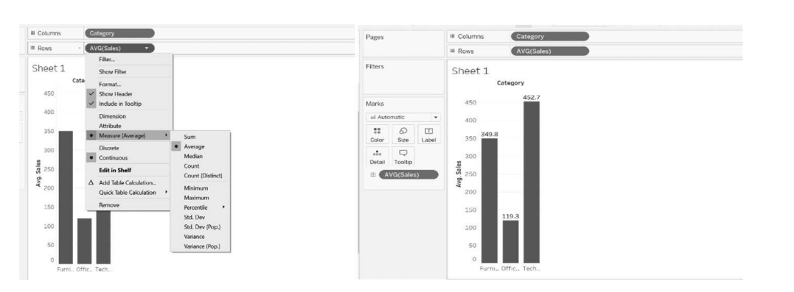

Slide 20
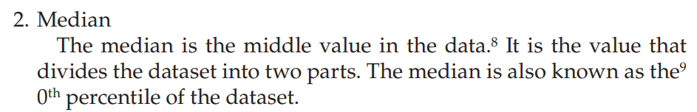
To calculate the median profit in each category. Execute the following steps to get the median:
Step 1: Drag the dimension Category and the measure Profit to the canvas area
Step 2: To get the median, right-click on the Profit field and select the Measure (Median) method.
Step 3: To get the packed bubbles in different colors and in different sizes, drag the Category field to the Color property and the MEDIAN(Profit) to the Size property under the Marks shelf, respectively.
Step 4: To get the median to be displayed on the respective bubbles, drag the Category and the Profit field from the canvas area itself to the Label property under the Marks shelf.

Slide 21
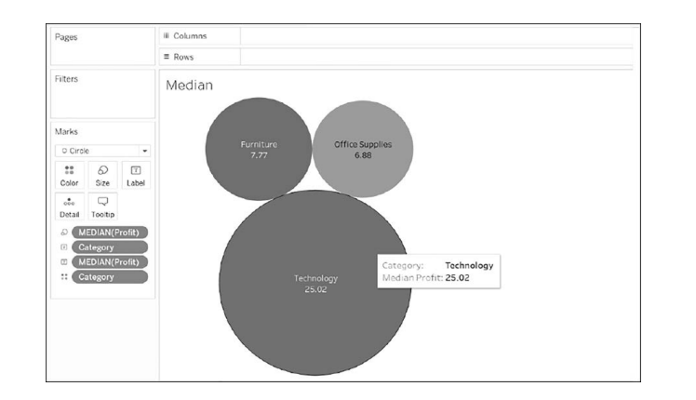

Slide 22
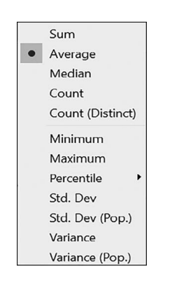

Slide 23
Worksheet Summary Card :
Tableau also provides us a feature known as the Summary Card. The Summary Card gives us a summary of the visuals that have plotted in the canvas area.
The Summary Card provides all the descriptive statistics methods.
Let’s take the example that calculating the median using the packed bubbles.
To get the Summary Card for this example, the following steps must be carried out.
Step 1: In the tab window, right-click the Worksheet tab and select Show Summary. Once you click on the Show Summary, the Summary Card will be activated on the right of the screen.
Step 2: You can place this Summary Card anywhere by just dragging it on the screen.
Step 3: Right-click on the Summary tab in the Summary Card and select or deselect the metrics as per the requirements.

Slide 24
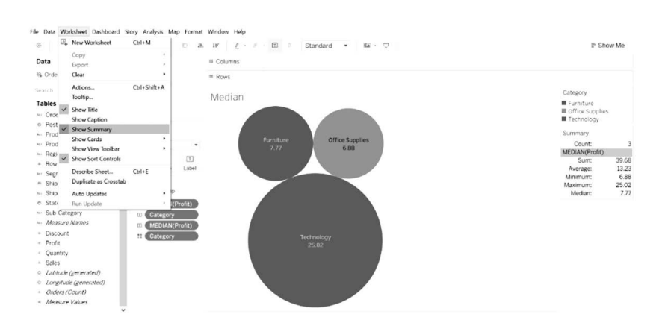

Slide 25
Basic Charts
Tableau can provide interactive charts.
Different types of charts are created using various measures and dimensions.
The Show Me tab suggests various chart types based on the measures and dimensions selected by the user.
A bar chat appears on the canvas area by default when a dimension is selected followed by a measure.
Similarly, a textual representation of data is displayed on the canvas area when a measure is selected followed by a dimension.

Slide 26
The following are the various types of basic charts in Tableau.
1. Bar chart
2. Area chart
3. Line chart
4. Bullet chart
5. Scatter plot
6. Box-whisker plot
7. Pie chart
8. Bubble chart
9. Histogram
10. Highlight table
11. Gantt chart
12. Heat map

Slide 27
1. Area Chart :
Area charts are mostly used to analyze numeric data over different time periods. The area chart is just an extension to the line chart where the area between the lines and the axis is filled with color. To analyze the Sales per category over the Order Date.
Execute the following steps to create an area chart:
Step 1: Drag the dimension Order Date to the Columns shelf and the measure Sales to the Rows shelf.
Step 2: Change the chart type from Automatic to Area under the Marks pane.
Step 3: Change the Order Date type to Month.
Step 4: Drag the dimension Category to the Colors property under the Marks pane.

Slide 28
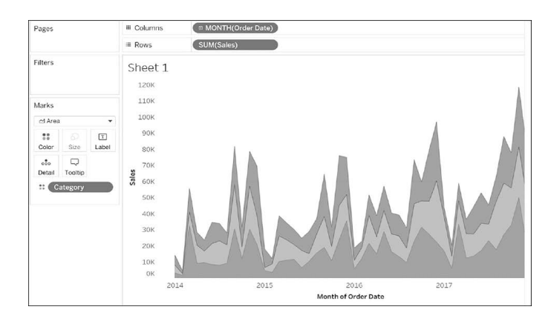

Slide 29
2. Scatter Plots
Scatter plots are used to find relationships between two or more variables. Scatter plots are majorly used to find out trends in the data. A scatter plot displays discrete data points on the graph. Say, we have to find the relationship between the sales and the profit based on the subcategory.
To create a scatter plot, perform the following steps:
Step 1: Drag the measures Sales and Profit to the Columns and Rows shelves, respectively.
Step 2: Drag the dimension Sub-Category to the Colors property under the Marks pane .

Slide 30
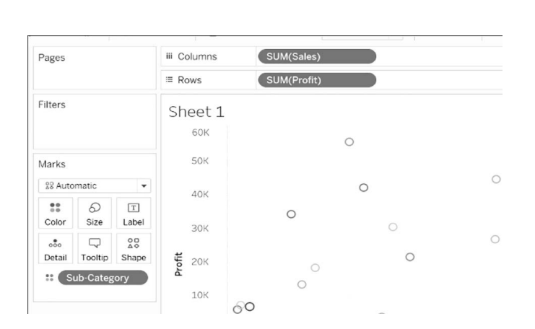

Slide 31
3. Box-whisker plot
Box-whisker plots are also known as the boxplots. Box-whisker plots are normally used to showcase the data distributions. The box in the plot represents the first, second, and third quartiles. The whiskers represent the maximum and the minimum data points of the data.
Step 1: Drag the dimension Segment and measure Discount to the Columns and Rows shelves, respectively.
Step 2: Drag the dimension Region to the right of the Segment in the Columns shelf.
Step 3: Select the box-whisker plot under the Show me tab.
Step 4: Replace the dimension Region in the Marks shelf to the right of the dimension Segment under the Columns shelf.
Step 5: Deselect Aggregate Measures under the Analysis tab.
Step 6: Edit the colors by right-clicking the vertical axis and selecting Edit Reference Line.

Slide 32
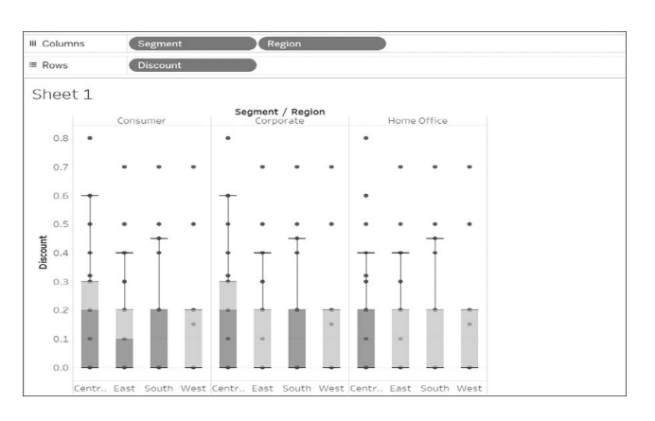

Slide 33
4. Heat map
Heat maps are majorly used to analyze the data with various categories using colors. The heat map can compare hundreds and thousands of categories and make it simple to interpret. Suppose, using the Sample Superstore dataset, we want to analyze the trends in the data of the Sales in accordance with the Order Date by plotting a line graph. Such a line graph will create an overlapping of lines which will cause trouble to analyze the graph. In such cases, a heat map is a better alternative to find the trends in data. Perform the following steps to create a heat map in the Tableau.

Slide 34
Step 1: Drag the dimension Order Date and dimension Sub- Category to the Columns and Rows shelves, respectively.
Step 2: Change the Order Date type to Month.
Step 3: Change the Mark type to Circle under the Marks tab.
Step 4: To get the encoding, drag the measure Sales to the Colors and Size property under the Marks tab.

Slide 35
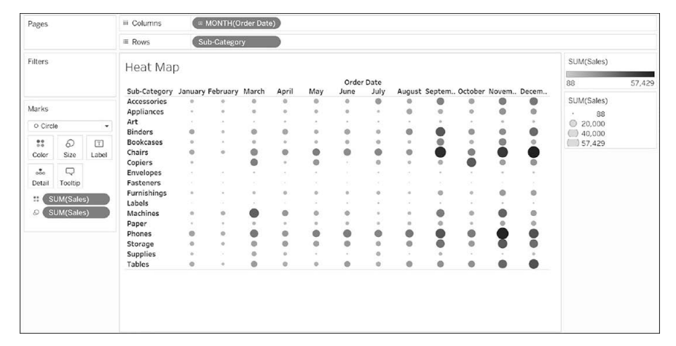

Slide 36
Dashboard Design & Principles
A dashboard is an interactive representation of united worksheets and all the essential information. Dashboards are mainly used to compare various data at one go.
Steps to create a dashboard from the Sample Superstore dataset to analyze the profit performance by the country.
Step 1: Go to the new dashboard worksheet by navigating the Sample Superstore sheet.
Step 2: Drag the sheets from the left of the dashboard section to the canvas area. You can also add them by double-clicking the sheets.

Slide 37
Step 3: Check the Show Dashboard Title and add the dashboard title.
Step 4: Fit the view with respect to the available space.
Step 5: Place the Profit legend with respect to the sheet.
Step 6: Take time to interact with the dashboard

Slide 38
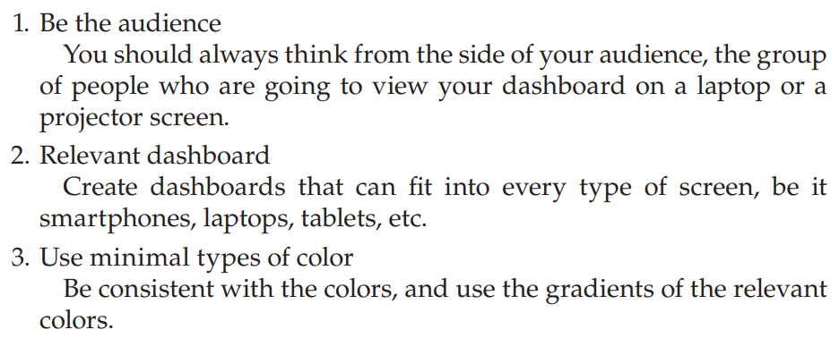
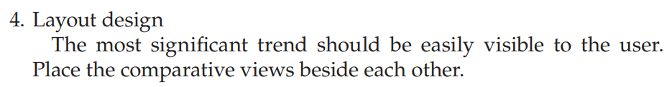
Dashboard design principles: Dashboard design principles play a vital role in the process of creating a dashboard. Using the below principles, one will easily be able to make interactive, data-driven dashboards.

Slide 39
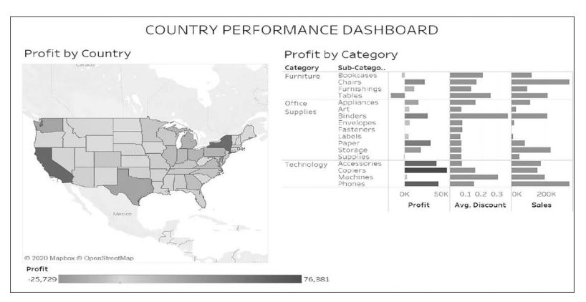

Slide 40
Joins and Blends
In Tableau, joins and blends are methods to combine data from different sources for analysis.
Understanding when and how to use each is crucial for building efficient and accurate visualizations.
1. Joins in Tableau
A join is a way to combine two tables (from the same data source) based on a common field (key).

Slide 41
Types of Joins
Inner Join: Returns only matching rows from both tables.
Left Join: Returns all rows from the left table and matching rows from the right table.
Right Join: Returns all rows from the right table and matching rows from the left table.
Full Outer Join: Returns all rows from both tables, with NULL where there is no match.

Slide 42
How to Perform Joins in Tableau
Go to the Data Source tab.
Drag the first table to the canvas.
Drag the second table next to it. Tableau will prompt you to create a join.
Choose the common field(s) for the join and the type of join.

Slide 43
When to Use Joins
Both datasets share a common schema or key field (e.g., Customer ID or Product Code).
Complete dataset needed in a single table for analysis.
Both tables come from the same data source (e.g., SQL database, Excel workbook).
Example
Combine a Sales table with a Customers table using Customer ID to see sales performance by customer demographics.

Slide 44
2. Blends in Tableau
A blend is used to combine data from two different data sources. It’s Tableau's way of federated querying.
How Blending Works
Tableau establishes a primary data source (denoted by a blue checkmark) and one or more secondary data sources.
Blending is done at an aggregate level rather than row-level matching.

Slide 45
Steps for Blending
Connect to multiple data sources.
Create a relationship: Add the primary data source to the worksheet. Then add a field from the secondary data source. Tableau will automatically link them using common fields (indicated by an orange link icon).
If Tableau doesn't auto-detect relationships, go to Data > Edit Relationships to define the linking fields.

Slide 46
When to Use Blends
The datasets come from different sources (e.g., SQL and Excel, or two different servers).
You need to combine aggregated data rather than raw data.
A join isn’t possible due to mismatched row-level granularity.
Example
Combine sales data from a database (e.g., SQL Server) with target data from an Excel file to compare actual vs. target sales.

Slide 47
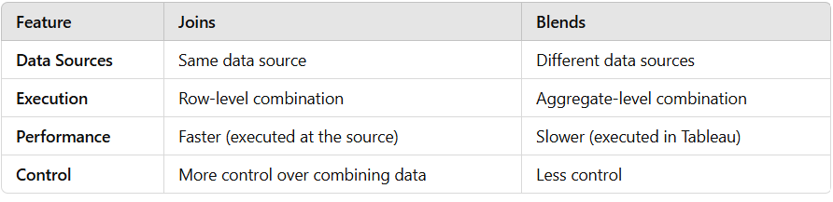
Key Differences Between Joins and Blends

Slide 48
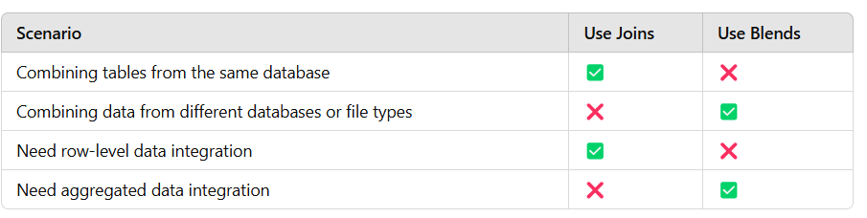
When to Choose Which

Slide 49
Filtering data
Filtering data in Tableau helps refine your analysis by limiting the data displayed in your visualizations.
Tableau offers several types of filters that can be applied at different stages of the analysis process.

Slide 50
Filter Types in Tableau
Dimension Filters
Use Case: Filter specific categories, groups, or text-based fields.
Example: Show only sales for the "Technology" category.
How to Apply:
Drag a dimension (e.g., Category) to the Filters shelf.
In the dialog box, check the values you want to include.

Slide 51
Measure Filters
Use Case: Filter numeric data based on conditions or ranges.
Example: Display sales greater than $10,000.
How to Apply:
Drag a measure (e.g., Sales) to the Filters shelf.
Set the range or condition in the filter dialog.

Slide 52
Date Filters
Use Case: Focus on specific time periods.
Example: Show data from 2023 only.
How to Apply:
Drag a date field to the Filters shelf.
Choose from options like relative dates (e.g., last month), range of dates, or individual date parts (e.g., years).

Slide 53
Context Filters
Use Case: Prioritize a filter and make it the context for all subsequent filters.
Example: Filter "Region = East" and then apply additional filters for specific products.
How to Apply:
Right-click a filter and select Add to Context.
The filter turns gray, indicating it's a context filter.

Slide 54
Top N Filters
Use Case: Show the top or bottom N values.
Example: Display the top 10 products by sales.
How to Apply:
Drag a dimension (e.g., Product) to the Filters shelf.
Choose Top and specify a number and measure (e.g., Top 10 by Sales).

Slide 55
Wildcard Filters
Use Case: Filter text fields using patterns.
Example: Show only customers whose names start with "A."
How to Apply:
Drag a dimension (e.g., Customer Name) to the Filters shelf.
Choose Wildcard and enter your pattern (e.g., A*).

Slide 56
Data Source Filters
Use Case: Apply global filters to limit data retrieved from the source.
Example: Restrict the data source to only include records from 2023.
How to Apply:
Go to the Data Source tab.
Click Add under Filters and specify your criteria.

Slide 57
Interactive Filters for Dashboards
Add a filter directly to a worksheet and then enable it as an interactive filter in a dashboard:Right-click a field in the Filters shelf and select Show Filter.
Tableau displays a filter card in the view, allowing users to interact.

Slide 58
Filter Order of Operations
Filters in Tableau are applied in a specific order:
Extract Filters (if used)
Data Source Filters
Context Filters
Dimension Filters
Measure Filters
Table Calculations

Slide 59
Row-level calculations in tableau
Row-level calculations in Tableau allows to manipulate and derive data at the row level of dataset. These calculations operate on each individual row of data source, unlike aggregate calculations that summarize data across multiple rows.
1. Characteristics of Row-Level Calculations
Operate on individual rows: Calculations are performed for each row independently.
Non-aggregated data: Use raw, unaggregated fields in the calculation.
Output per row: The result of the calculation is available for every row of the dataset.

Slide 60
2. Common Use Cases
Create new fields based on existing ones.
Clean data (e.g., removing spaces, standardizing formats).
Perform conditional logic (e.g., classify values into categories).
Combine fields (e.g., concatenate first and last names).
Extract parts of strings (e.g., domain names from email addresses).

Slide 61
3. How to Create a Row-Level Calculation
Go to the Data Pane.
Click the Dropdown next to a field > Create Calculated Field.
Enter formula in the calculated field editor.
Use raw fields (no aggregation functions like SUM, AVG, etc.).

Slide 62
4. Examples of Row-Level Calculations
4.1 Mathematical Operations
Perform calculations across fields:
Formula: [Quantity] * [Price]
Use case: Calculate the total cost for each row.
4.2 Conditional Logic
Use IF, CASE, or IIF statements to derive new fields:
Formula: IF [Sales] > 1000 THEN 'High' ELSE 'Low' END
Use case: Categorize sales into "High" or "Low"

Slide 63
4.3 Text Manipulation
Work with string fields:
Concatenation: CONCAT([FirstName], ' ', [LastName])
Use case: Combine first and last names into a single field.
Trimming: TRIM([Field])
Use case: Remove leading/trailing spaces.
Extract part of a string: LEFT([Email], FIND([Email], '@') - 1)
Use case: Extract the username from an email address.

Slide 64
4.4 Date Calculations
Work with date fields:
Calculate time intervals: DATEDIFF('day', [Order Date], [Ship Date])
Use case: Calculate shipping duration for each order.
Create new date fields: DATEADD('month', 1, [Order Date])
Use case: Calculate the date one month after the order date.

Slide 65
4.5 Logical Operations
Combine multiple conditions:
Formula: IF [Region] = 'East' AND [Sales] > 5000 THEN 'Key Customer' ELSE 'Regular' END
Use case: Flag key customers based on region and sales threshold.

Slide 66
5. Example Use Case
Scenario: Calculate Profit Margin for Each Sale
Fields in the dataset:
Sales
Profit
Row-Level Calculation Formula:css
Copy code
[Profit] / [Sales]
Outcome: Profit margin is calculated for every sale record.

Slide 67
Aggregate-level calculations
Aggregate-level calculations in Tableau operate on aggregated data rather than individual rows.
These calculations summarize or manipulate groups of data (e.g., totals, averages, or other metrics) and are crucial for analyzing trends, comparing metrics, and summarizing datasets.
1. Characteristics of Aggregate Calculations
Operate on summarized data: Use aggregation functions like SUM, AVG, COUNT, etc.
Perform operations at a group level: Calculations apply to dimensions or combinations of dimensions in the view.
Require aggregation: All fields in the formula must use aggregation if any field is already aggregated.

Slide 68
2. Common Use Cases
Calculate total or average sales for each region.
Compare percentages, such as contribution to total.
Compute ratios or indices (e.g., profit margin or growth rate).
Find maximum or minimum values across groups.

Slide 69
3. How to Create an Aggregate Calculation
Go to the Data Pane.
Click the Dropdown next to a field > Create Calculated Field.
Enter formula using aggregate functions like SUM, AVG, COUNT, etc.
Use this calculated field in view to group or summarize data.

Slide 70
4. Examples of Aggregate Calculations
4.1 Sum
Formula: SUM([Sales])
Use case: Calculate the total sales for each category or region.
4.2 Average
Formula: AVG([Profit])
Use case: Find the average profit per product or customer.
4.3 Percentage of Total
Formula: SUM([Sales]) / SUM({FIXED : SUM([Sales])})
Use case: Compute each region's sales as a percentage of total sales

Slide 71
4.4 Maximum or Minimum
Formula: MAX([Order Value])
Use case: Identify the largest order value in each region.
4.5 Count
Formula: COUNT([Order ID])
Use case: Count the number of orders per customer.
4.6 Weighted Average
Formula:scss
Copy code
SUM([Score] * [Weight]) / SUM([Weight])
Use case: Compute weighted averages for scores or ratings.

Slide 72
4.7 Ratios
Formula (Profit Margin): SUM([Profit]) / SUM([Sales])
Use case: Calculate the profit margin for each product or category.

Slide 73
5. Aggregate Calculations with Level of Detail (LOD) Expressions
For advanced aggregations, combine aggregate functions with LOD expressions to control granularity.
Fixed LOD Example
Formula: {FIXED [Region]: SUM([Sales])}
Use case: Calculate total sales for each region, ignoring filters in the view.
Include LOD Example
Formula: {INCLUDE [Product]: AVG([Sales])}
Use case: Include product-level detail while aggregating at a higher level.
Exclude LOD Example
Formula: {EXCLUDE [Category]: SUM([Sales])}
Use case: Calculate total sales while excluding the Category dimension from the aggregation.

Slide 74
6. Using Aggregate Calculations in Views
In Text Tables or Summaries
Drag aggregate fields (e.g., SUM([Sales])) directly to the view to summarize data.
In Graphs
Use aggregate fields to create visual comparisons (e.g., bars representing SUM([Sales]) by region).
In Dashboards
Use aggregate calculations to highlight KPIs or trends.

Slide 75
7. Nested Aggregate Calculations
You can nest aggregate functions for advanced calculations:
Example: Find the average of total sales per region:
AVG(SUM([Sales]))
Tableau will compute the SUM([Sales]) for each region and then calculate the average across all regions.

Slide 76
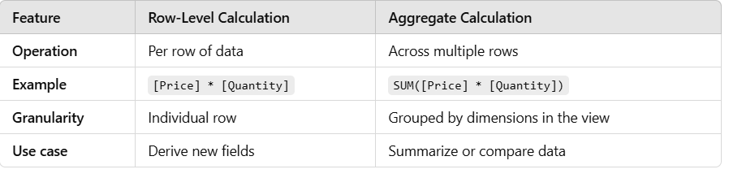
Aggregate vs. Row-Level Calculations

Slide 77
level of detail calculations
Level of Detail (LOD) calculations in Tableau allows to perform advanced aggregations while controlling the level of granularity at which calculations are performed.
These calculations gives the flexibility to aggregate data at a fixed level of detail, regardless of the view's current level of granularity.

Slide 78
1. Types of LOD Calculations
1.1 FIXED
Purpose: Compute values at a specific level of detail, independent of the dimensions in the view.
Syntax: {FIXED <Dimension(s)> : <Expression>}
Use Case: Calculate total sales for each region, regardless of the filters or dimensions in the current view.
Example:
{FIXED [Region] : SUM([Sales])}
This computes total sales for each region, unaffected by other dimensions in the view.

Slide 79
1.2 INCLUDE
Purpose: Add dimensions to the current level of detail in the view.
Syntax: {INCLUDE <Dimension(s)> : <Expression>}
Use Case: Calculate per-product average sales within a view that only shows category-level data.
Example:
{INCLUDE [Product] : AVG([Sales])}
This computes average sales for each product, even if the view aggregates data at the category level.

Slide 80
1.3 EXCLUDE
Purpose: Remove dimensions from the current level of detail in the view.
Syntax: {EXCLUDE <Dimension(s)> : <Expression>}
Use Case: Calculate total sales for each region, excluding product-level detail in a view showing both region and product.
Example:
{EXCLUDE [Product] : SUM([Sales])}
This calculates total sales for each region, ignoring product details in the view.

Slide 81
2. How to Create an LOD Calculation
Open the Data Pane in Tableau.
Right-click anywhere in the pane and select Create Calculated Field.
Write your LOD expression using {FIXED}, {INCLUDE}, or {EXCLUDE}.
Name the calculated field and click OK.
Drag the new field into your worksheet to see the results.

Slide 82
3. When to Use LOD Calculations
To fix aggregation levels across filters or dimensions in the view.
To calculate row-level granularity and then aggregate it differently.
To compare group-level metrics with overall metrics.
To perform calculations at a granularity different from the view.

Slide 83
4. Examples of LOD Calculations
4.1 Fixed LOD Calculation
Scenario: Total sales by region, ignoring product-level granularity.
Calculation: {FIXED [Region] : SUM([Sales])}
Outcome: Displays total sales for each region, even if the view includes additional dimensions like Product.
4.2 Include LOD Calculation
Scenario: Average sales per product within categories.
Calculation: {INCLUDE [Product] : AVG([Sales])}
Outcome: Computes average sales for each product, even in a view showing category-level aggregates.

Slide 84
4.3 Exclude LOD Calculation
Scenario: Total sales by region, excluding customer details.
Calculation: {EXCLUDE [Customer Name] : SUM([Sales])}
Outcome: Displays regional sales totals without considering customer-level granularity.

Slide 85
5. Combining LOD Calculations with Filters
Include LOD respects filters applied to the view.
Fixed LOD ignores most filters except data source filters and context filters.
Exclude LOD adjusts aggregations by removing specified dimensions.

Slide 86
6. Practical Use Cases
6.1 Comparing Individual Contribution to Group Total
Calculate each product's sales as a percentage of total category sales:
{FIXED [Category]: SUM([Sales])}
[Sales] / {FIXED [Category]: SUM([Sales])}
6.2 Find Top Performers
Highlight top-performing regions by comparing regional sales to the overall average:
Overall average: {FIXED : AVG([Sales])}
Compare: IF SUM([Sales]) > {FIXED : AVG([Sales])} THEN 'Above Average' ELSE 'Below Average' END

Slide 87
6.3 Analyze Data at Multiple Levels
Compute per-customer sales while showing total sales at the regional level:
Customer sales: {FIXED [Customer Name]: SUM([Sales])}
Regional sales: {FIXED [Region]: SUM([Sales])}

Slide 88
7.Visualization with LOD Calculations
Use LOD fields in:
Bar Charts: Compare group-level and overall metrics.
Text Tables: Show multiple levels of detail in the same view.
Dashboards: Highlight KPIs derived from custom aggregation levels.

Slide 89
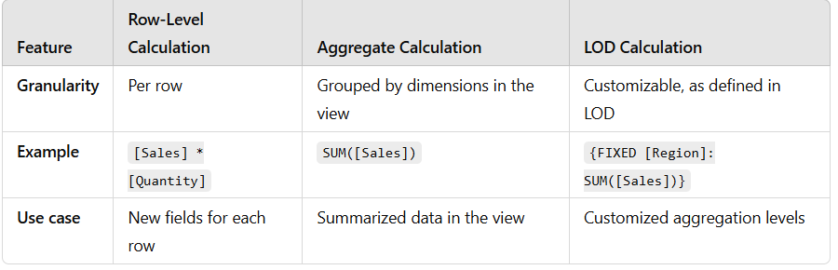
8.LOD Calculations vs. Row-Level and Aggregate Calculations

Slide 90
custom table calculations
Custom table calculations in Tableau are powerful tools to create computations on top of the data in visualization.
These calculations operate on the data already present in the view (not the underlying dataset) and are ideal for analyzing trends, rankings, percentages, moving averages, and more.

Slide 91
Steps to Create Custom Table Calculations
Add a Measure to the View:
Drag a measure to the view to create a chart (e.g., bar chart or line chart).
Access the Table Calculation:
Right-click on the measure in the Rows, Columns, or Marks shelf.
Select Add Table Calculation.

Slide 92
Choose a Calculation Type:
Select from built-in options like:
Running Total
Difference
Percent Difference
Rank
Percent of Total
Moving Average
Custom
Choose Custom to define specific logic.

Slide 93
Customize the Scope and Direction:
Choose how the calculation is applied across the data in the view:
Table (Across/Down/Across then Down): Across rows, columns, or both.
Pane (Across/Down/Across then Down): Within smaller partitions of the table.
Specific Dimensions: Manually select fields that define the scope.
Write Your Formula (if required):
For more advanced customizations, click Edit Table Calculation and write your formula using Tableau's calculation editor.

Slide 94
Example: Calculate Percent Difference
Scenario: Analyzing Sales Growth Over Time
Drag Order Date to Columns and Sales to Rows.
Right-click SUM(Sales) on the Rows shelf and choose Add Table Calculation.
Select Percent Difference from the Calculation Type dropdown.
Set the computation to calculate Table (Across) if the view is a line chart of monthly sales.

Slide 95
Special Chart Types
All Tableau users know the basic charts and graphs that can be easily plotted using the Show me tab which contains various charts, such as line chart, pie chart, heat maps, treemaps, etc. To make the visualization more interactive on the dashboard, Tableau also provides some advanced graphs that need a bit more computations than the graphs shown under the Show me tab. The following are the advanced graphs that we are going to cover in this chapter:
1. Motion chart
2. Bump chart
3. Waterfall chart

Slide 96
1. Motion Chart :
A motion chart is nothing but a chart that shows the transformation in data dynamically.
To dynamically see the trends of profit and sales over the years. A motion chart is created in the Tableau by performing the following steps:
Step 1: Drag the dimension Order Date to the Columns shelf and measures Profit and Sales to the Rows shelf.
Step 2: Change the format of the Order date to Month-Year by right clicking on it and then clicking on Custom under the More tab as shown below
Step 3: Drag the dimension Order Date to the Pages shelf and change the format accordingly.
Step 4: To recognize the current trend in the run-time motion chart, change the mark type under the Marks shelf from Automatic to All.
Step 5: Set the show to Trails under the Show history visible on the right side of the window.
Now, play the motion chart. You can control the motion chart by the tab that occurs on the right side of the window

Slide 97
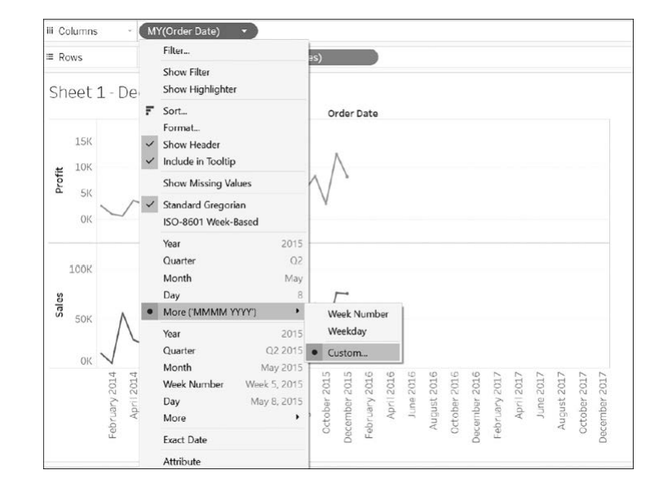

Slide 98
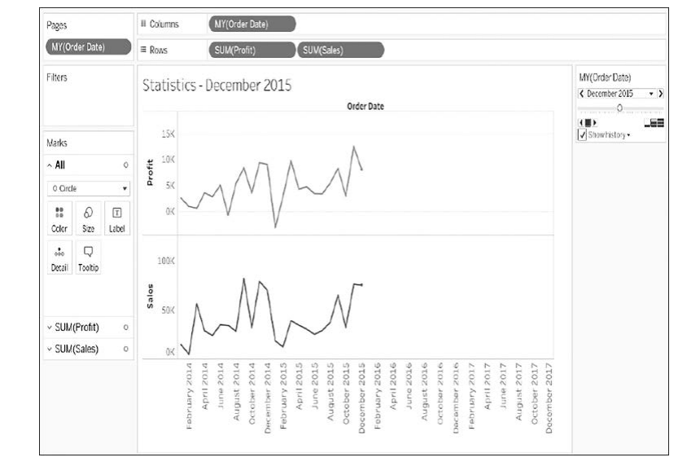

Slide 99
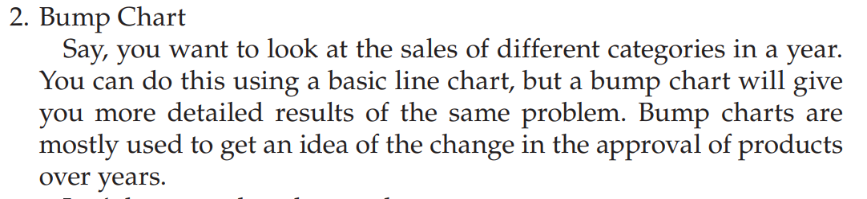
Step 1: Bump charts are created based on ranks. So, first, create a calculated field as shown below
Step 2: Drag Order Date to the Columns shelf and change its format to Month. Drag Category to the Colors property under the Marks pane. Also, drag the newly created calculated field Rank to the Rows shelf.
Step 3: To allocate the rank by the categories, right-click the Rank → Compute Using → Category.
Step 4: Drag the calculated field Rank to the Rows shelf again and repeat Step 3 Step 5: Right-click on the second Rank in the canvas area, and select Dual Axis.
Step 6: Alter the Mark type to Circle of either of the Rank under the Marks pane.
Step 7: Ranks can be reversed by the following navigation – Click on the axis → Edit Axis → Reversed Scale.

Slide 100
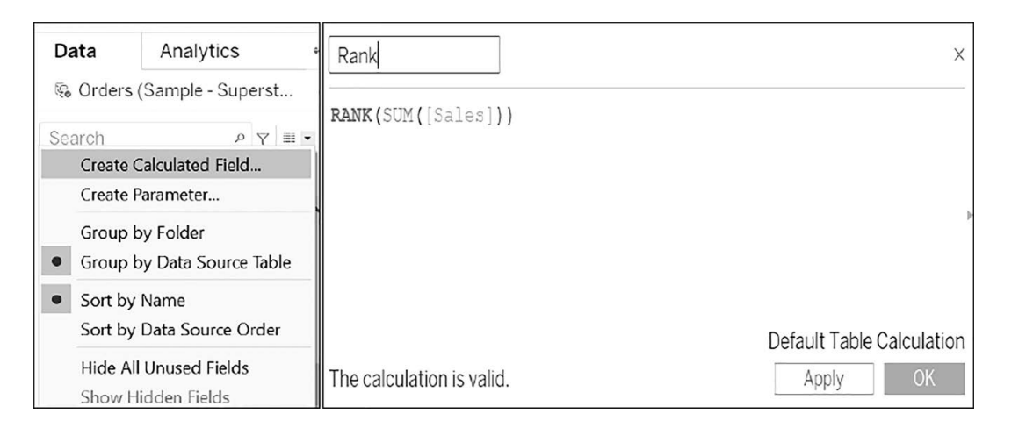

Slide 101
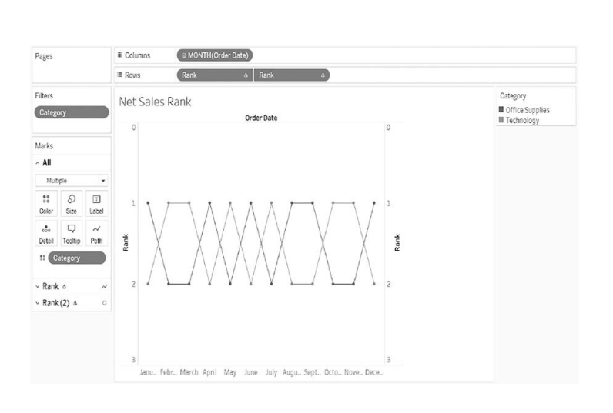

Slide 102
3. Waterfall Chart:
A waterfall chart is it depicts the flow between certain statistics.
A line chart is replaced by a waterfall chart as it is more interactive.
A waterfall chart is used to analyze a measure – its rise and fall over the years.
To achieve this, execute the following steps:
Step 1: Drag the Order Date and Profit to Columns and Rows shelves, respectively. Change the format of the Order Date to MonthYear and for the Profit, convert the Quick Table Calculation to Running Total. Step 2: Under the Marks pane, change the Mark type to Gantt Bar. You can also alter the size accordingly.
Step 3: Create a calculated field named Negative Profit and drag it to Size under the Marks pane. This field will fill the Gantt chart.
Step 4: Drag Profit to the type Color under the Marks pane

Slide 103
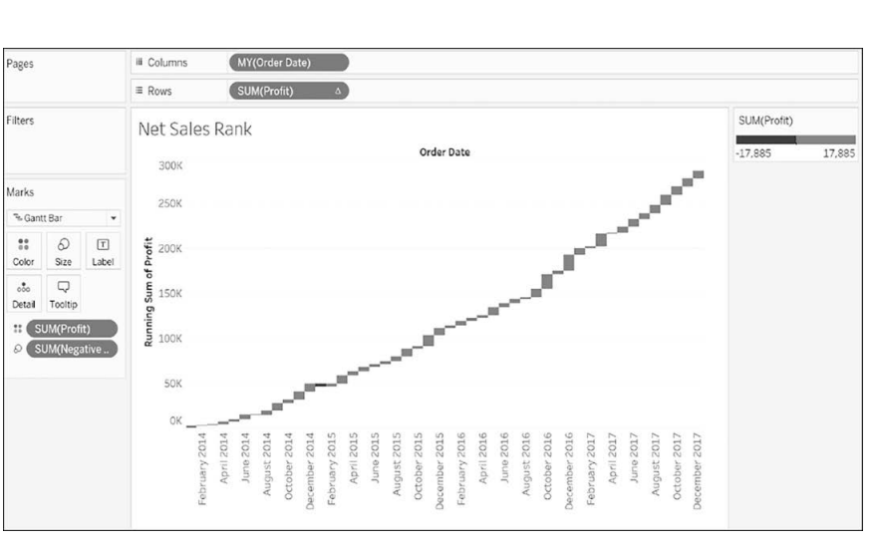

Slide 104
Integrate Tableau with Google Sheets
Google Sheets is a spreadsheet utility bestowed by Google.
Google Sheets is a web-based application and free of cost.
It is now possible to integrate Google Sheets in Tableau using the Google Sheets connector.
Tableau is strongly supported by Application Programming Interface (API) which helps us to get a seamless connection and gather productive insights.

Slide 105
To integrate Google Sheets in Tableau, execute the following steps:
Step 1: Open the Tableau application on device, go to the connect column, and select Google Sheets under the To a Server tab.
Step 2: After Step 1, it will directed to a page asking to sign into Google account.
Step 3: Grant Tableau permission to access the Google Sheets.
Step 4: Select the desired Google Sheet to integrate with Tableau.

Slide 106
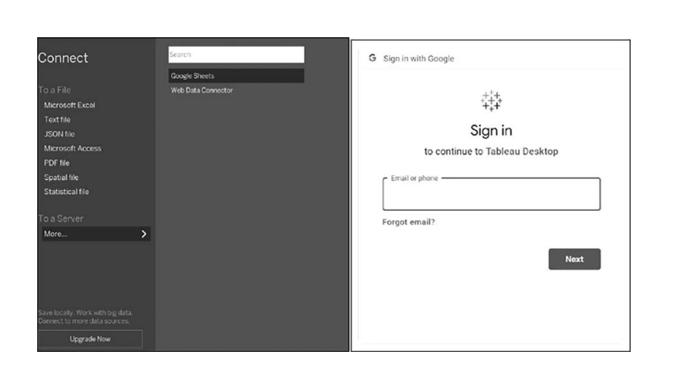

Slide 107
